Slide 1
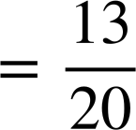
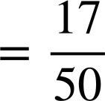
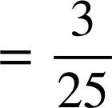
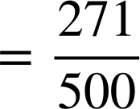
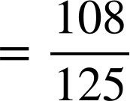
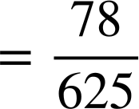






Converting terminating decimals to fractions
Task A: Fractions less than 1
1) Convert the following into simplified fractions:
a) 0.65
b) 0.34
c) 0.12
d) 0.542
e) 0.864
f) 0.1248
2) Laura and Jacob are given 0.56 and 0.560 to convert into a fraction.
Who is correct and work out the fractional equivalent to the decimal(s)?
The answers will be different as 0.56 is two decimals places and 0.560 is 3 decimal places.
It is the same decimal so it will be the same fraction.
Laura says
Jacob says
Both 0.56 and 0.560 are equal. They both are equivalent to
3a) Write the fraction which is halfway between 0.96 and 0.88
0.88
0.96
3b) Write the fraction which is a quarter of the way between 0.42 and 0.84
0.42
0.84

Slide 2

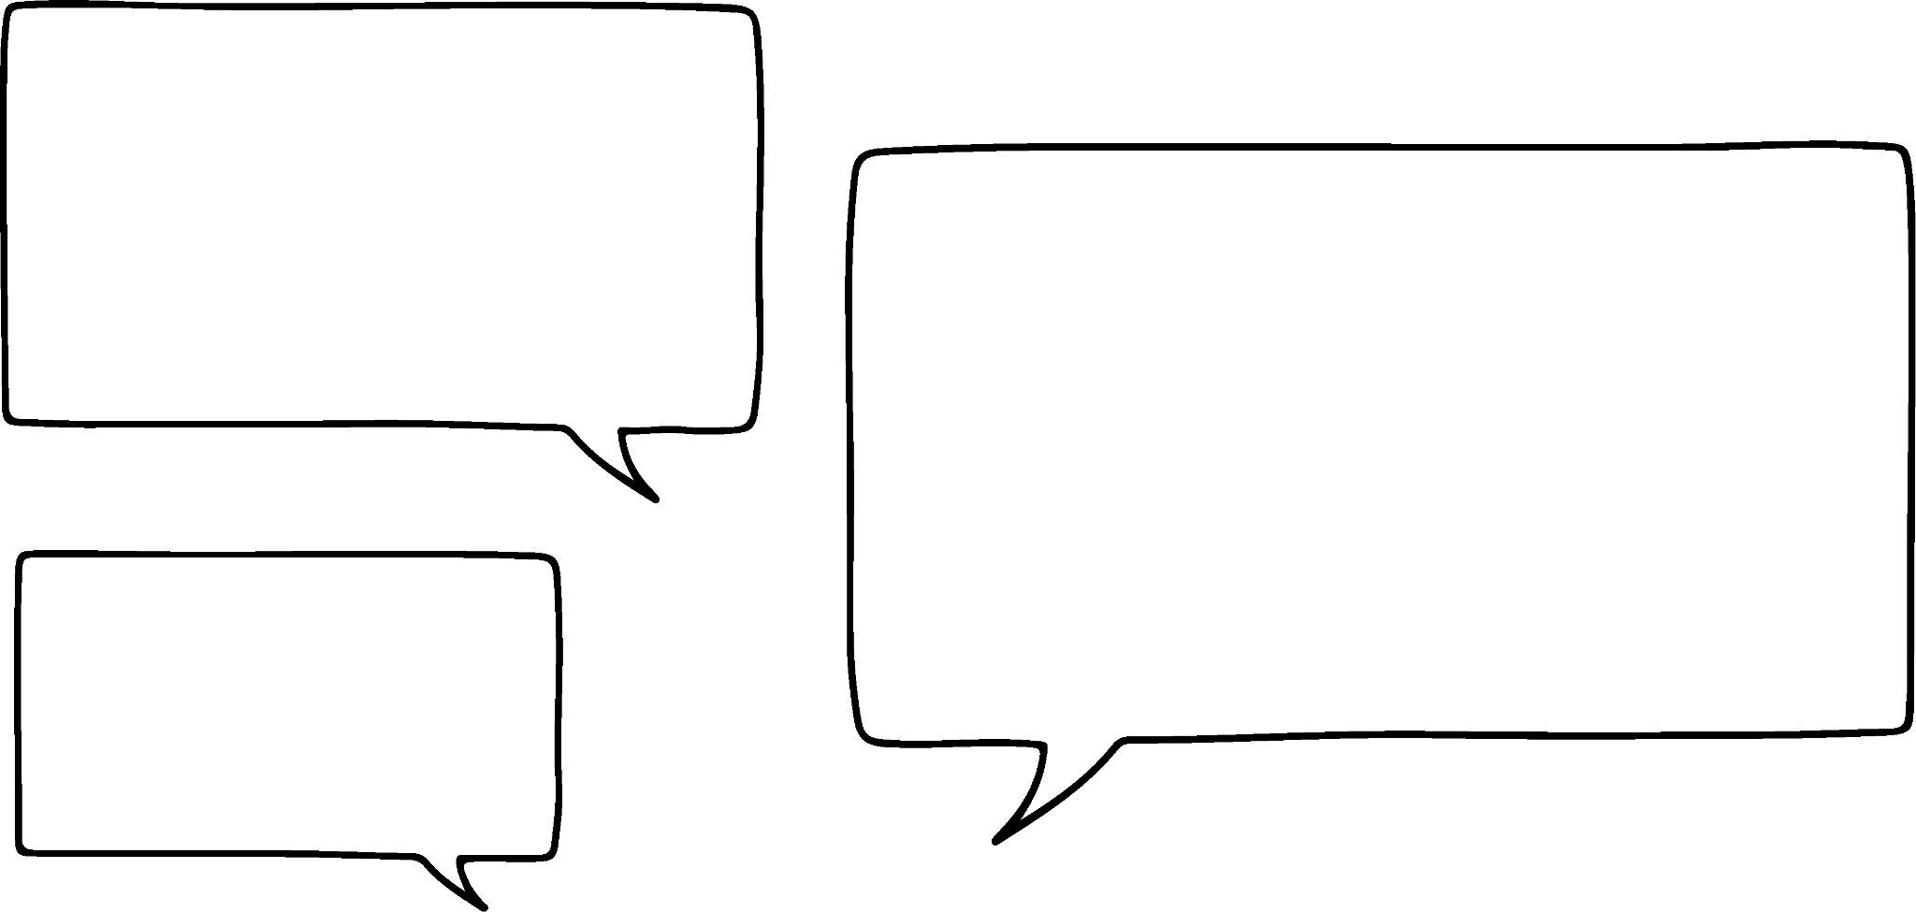
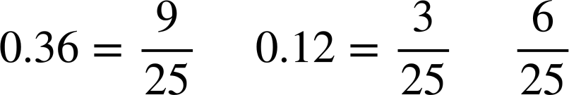


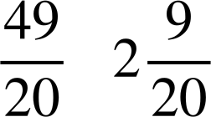
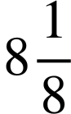

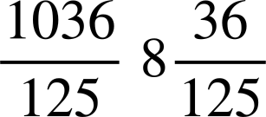
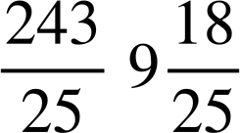
Converting terminating decimals to fractions
Three students created their own method to find the middle fraction.
3c) Do all three methods work? Explain.
0.12
0.36
I converted 0.12 and 0.36 into fractions. You can see the middle easily.
and so the middle fraction is
Izzy
Add 0.36 with 0.12, then halve the answer. Then find the fraction of the decimal.
0.36 + 0.12 = 0.48 then 0.48 ÷ 2 = 0.24 =
Aisha
Work out the difference between 0.36 and 0.12, then halve it and add it to 0.12. Convert this to a fraction.
Alex
0.36 - 0.12 = 0.24 then 0.24 ÷ 2 = 0.12 then 0.12 + 0.12 = 0.24 =
Task B: Fractions greater than 1
1) Convert the following decimals into mixed numbers and improper fractions.
Decimal | Mixed number | Improper fraction
2.45
8.125
8.288
9.72
‹#›

Slide 3
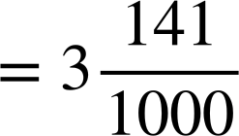
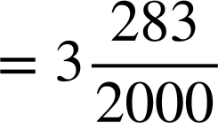
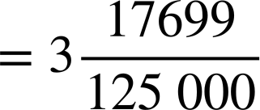
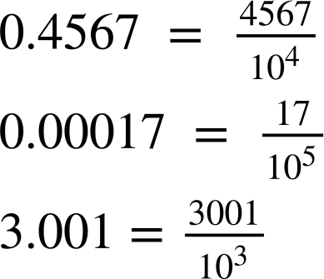
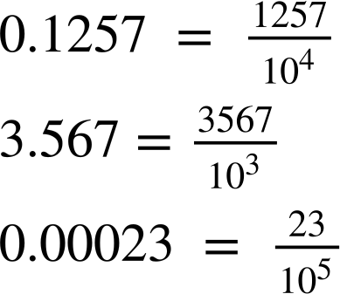
Converting terminating decimals to fractions
2)
𝝅 is a special symbol and represents the non-terminating decimal 3.141592654…
There is no fractional equivalent to the exact value of 𝝅.
Work out the mixed number equivalent to:
3.141
3.1415
3.141592
Task C: Writing the denominator in exponential form
1) Work out the power of the exponent.
a)
b)
c)
2) Write the following decimals as a fraction where the denominator is in exponential form.
b)
c)
a)
‹#›

Slide 4
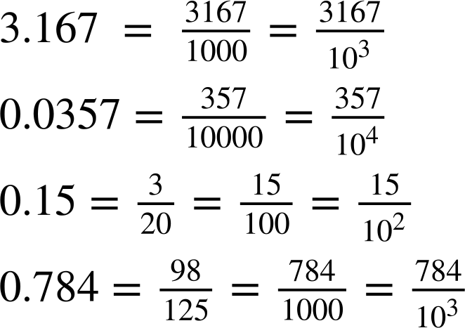
Converting terminating decimals to fractions
3) Fill in the gaps.
a)
b)
c)
d)
Mathematics in Education and Industry
v2.2

